Slide 1


Notes:
Hello and thank you for taking part in Jeans for Genes 2023!
Please feel free to use this primary school presentation to help you deliver a Jeans for Genes assembly or class talk in school. It is aimed to help your students understand why their support is so incredible and how their fundraising helps the genetic condition community in the UK.
It should only take around 10 mins to deliver, which leaves plenty of time for any questions there maybe!
Although Jeans for Genes is a week long event, we find that most schools in the UK get together on the Friday (21 Sept), creating a denim tidal wave of awareness and fundraising! Have fun!
*Start presentation*

Slide 2
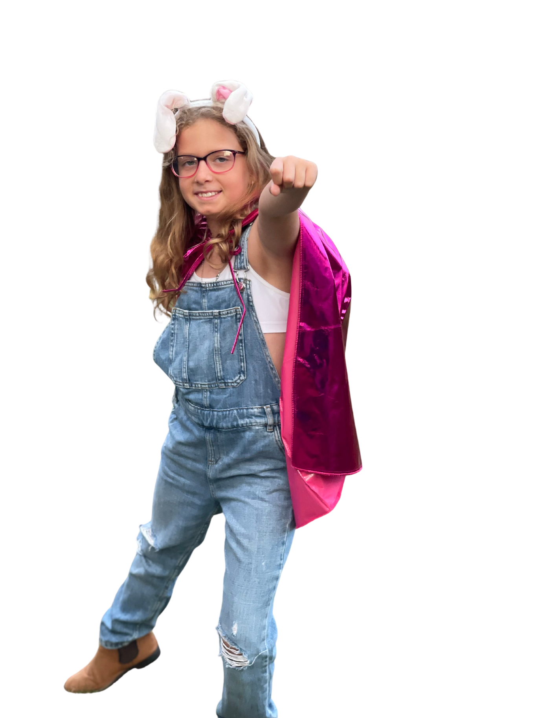
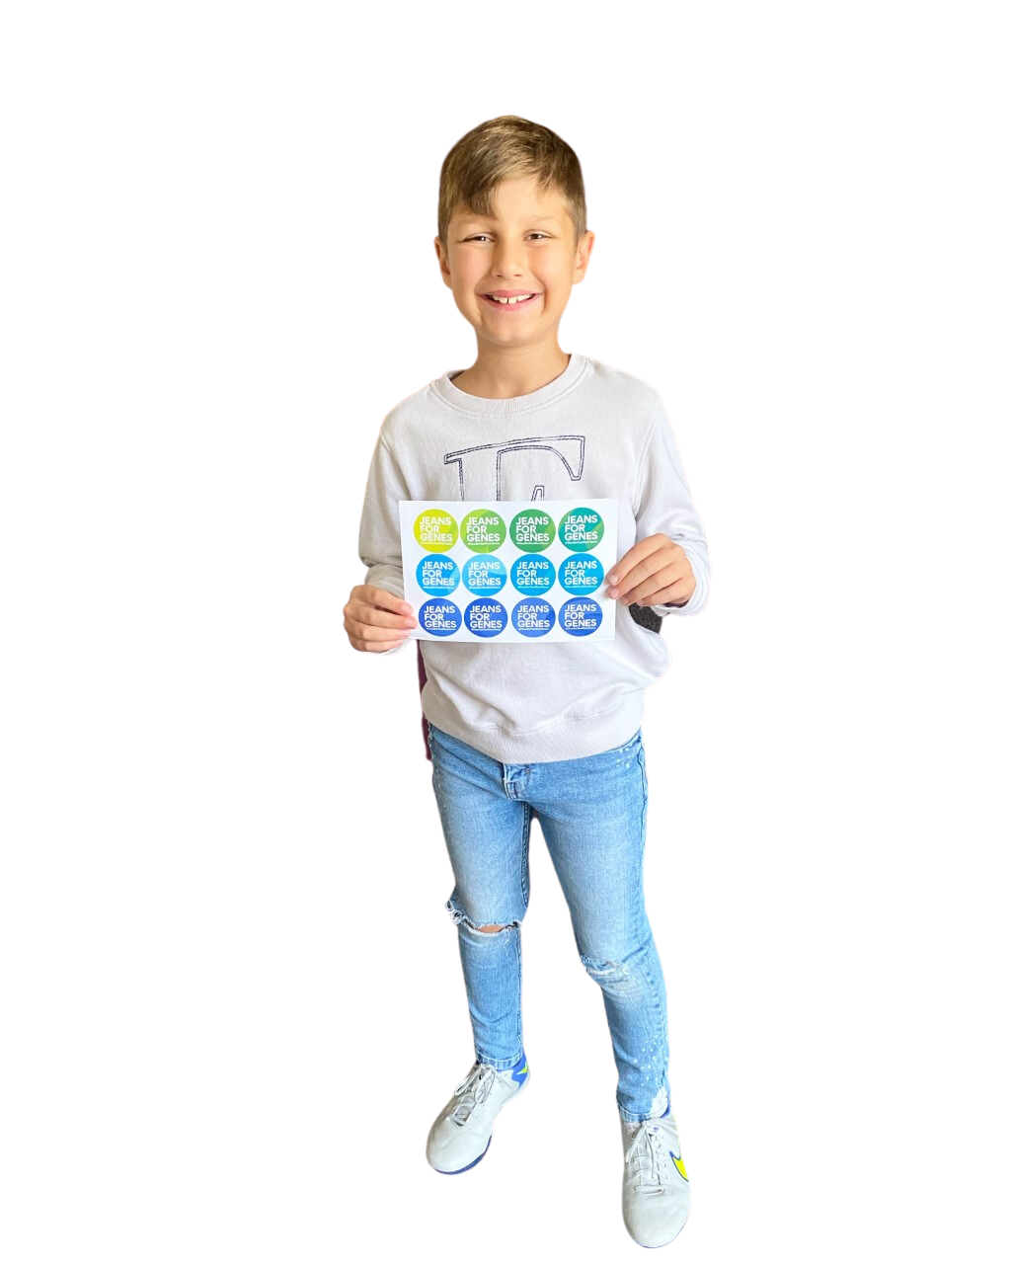

Notes:
What is Jeans for Genes?
Jeans for Genes is a charity here in the UK.
People raise money for Jeans for Genes by doing lots of fun activities - usually in jeans or denim!
This money helps children and families who have different needs because of the way that their bodies are made.
It takes place every September

Slide 3


Notes:
What are these? (point to jeans) JEANS! We wear them and they can be all different sorts of styles and come in many different shades of blue and lots of other clothes.
What are these? (point to genes) These are our GENES! They make us who we are and they also give us our freckles, our eye colour and our hair colour. Sometimes, when the genes are a little different, they can affect how we walk or talk and how our bodies move. The name for this is 'genetic condition'.

Slide 4

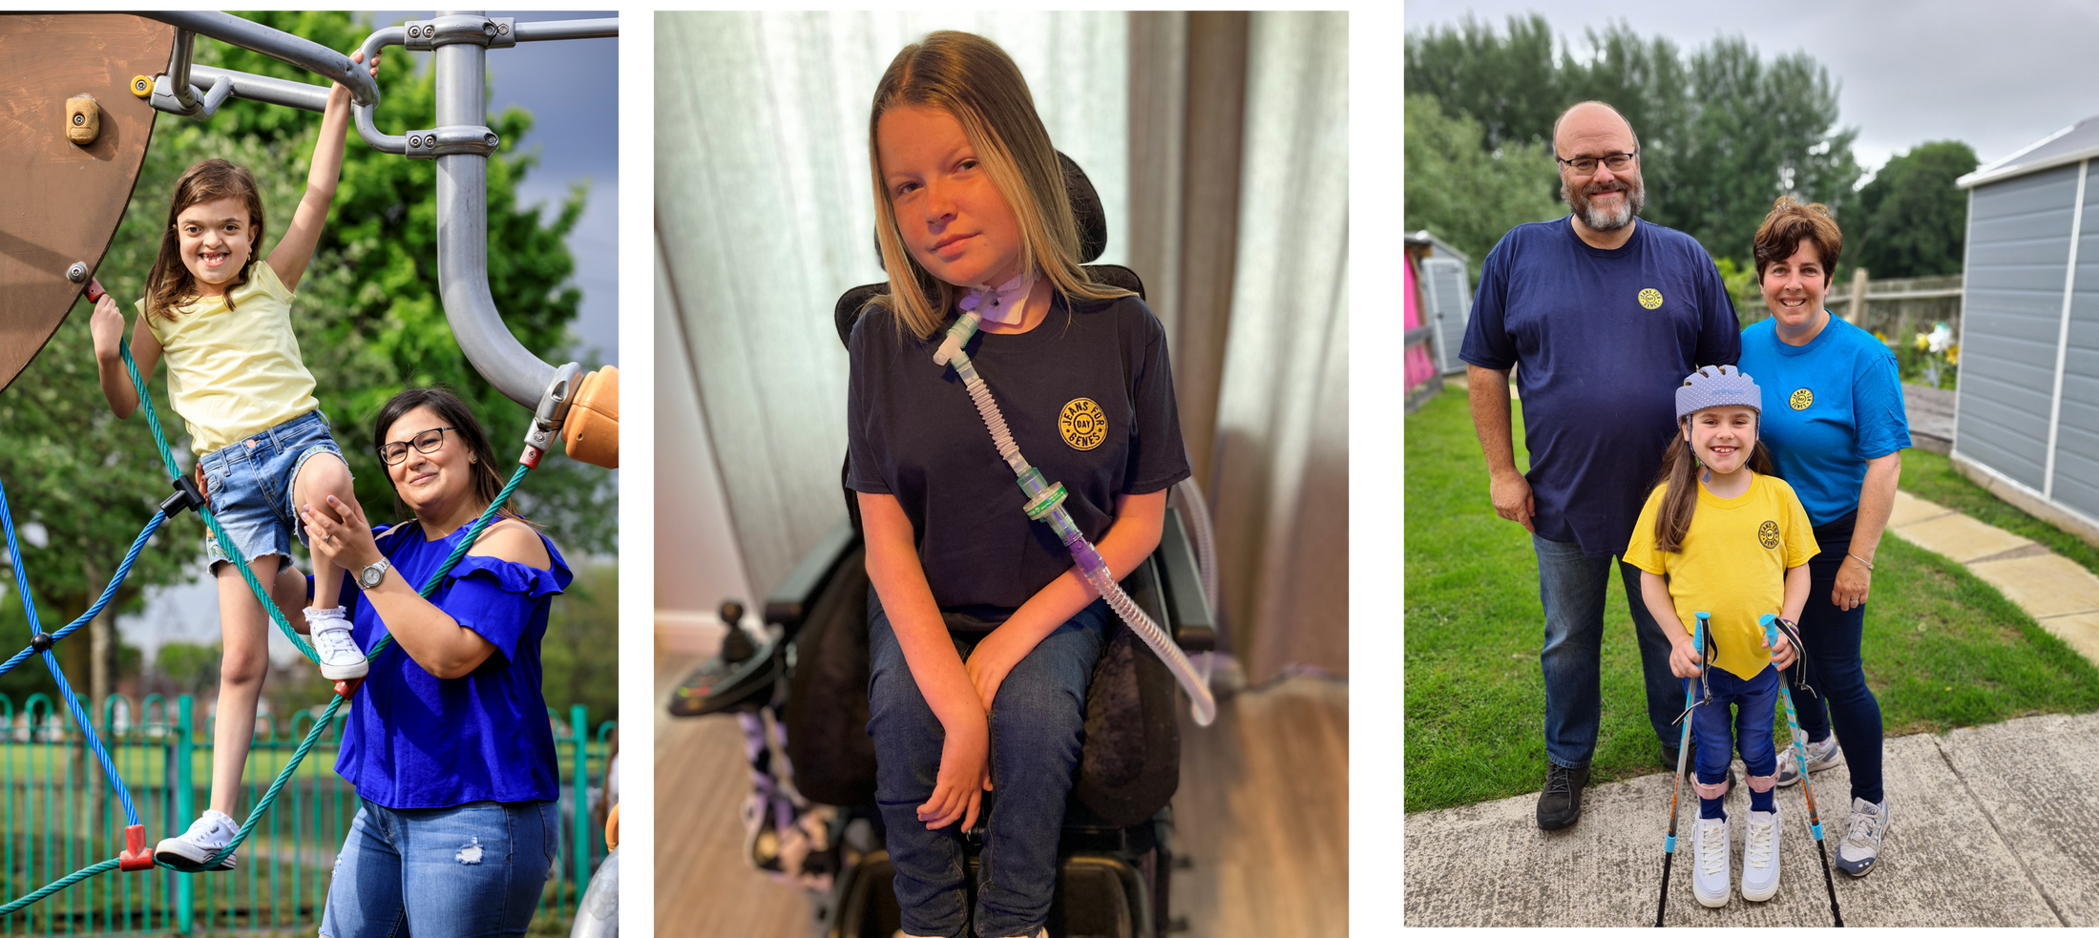
Why we need
YOUR HELP
Notes:
Why do we need your help?
1 in 25 children have different genes - which is 1 in 10 families in the UK.
For people with different genes, life can be difficult. It could be when they are babies and need a special nurse to help or when they go to school and need special equipment.
With your help, we can make sure that they get treatment and medical help when they need it.
Your help changes lives and makes a world of difference!

Slide 5
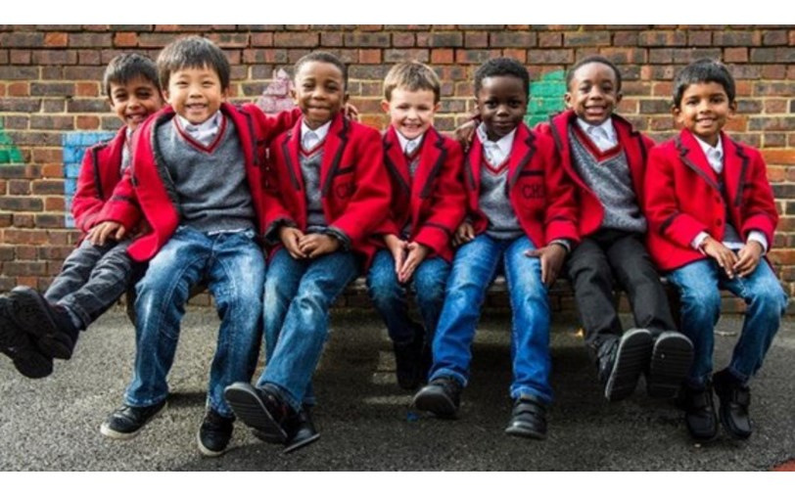
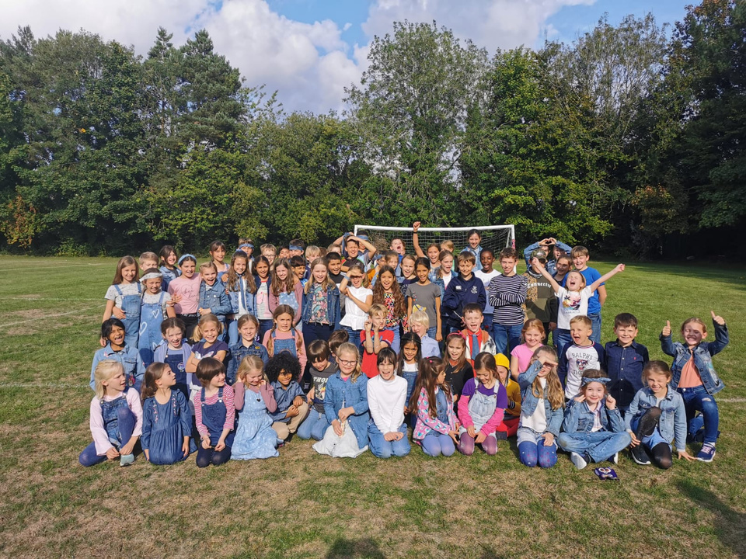
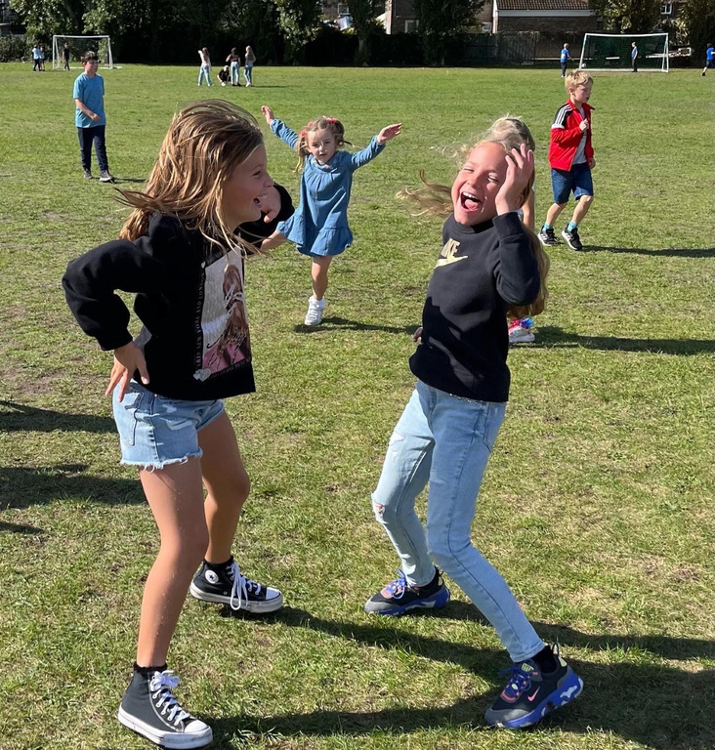
Better
TOGETHER
One way we have of raising money for Jeans for Genes is by simply wearing our jeans or some denim into school on a chosen day.
Simply bring £1 and all this money will help children all across the UK get access to the equipment, nurses and services that they need.
This is something EVERYONE can get involved with - students, teachers and Head Teachers alike!
Notes:
It's time to wear our jeans, do some good and have a lot of fun at the same time!
Every year we bring pupils, schools, workplaces and people together to help over 4 million people in the UK.
Let's make this year our best one yet!

Slide 6


Slide 7
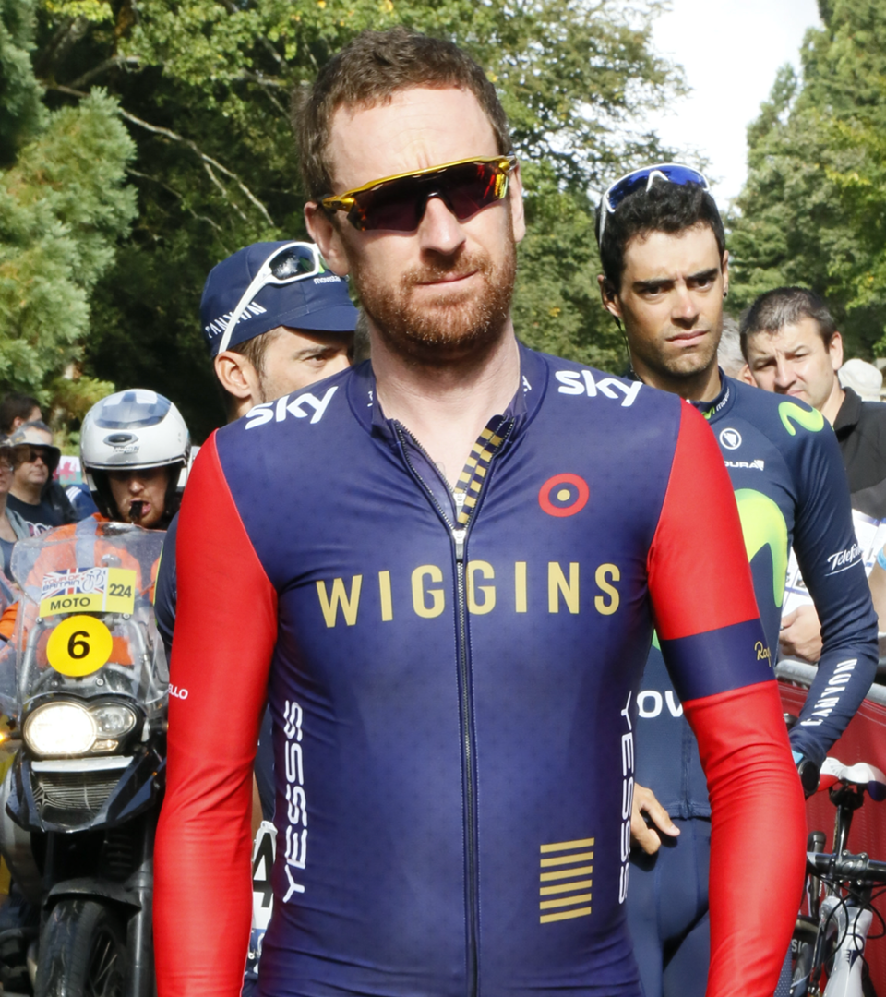
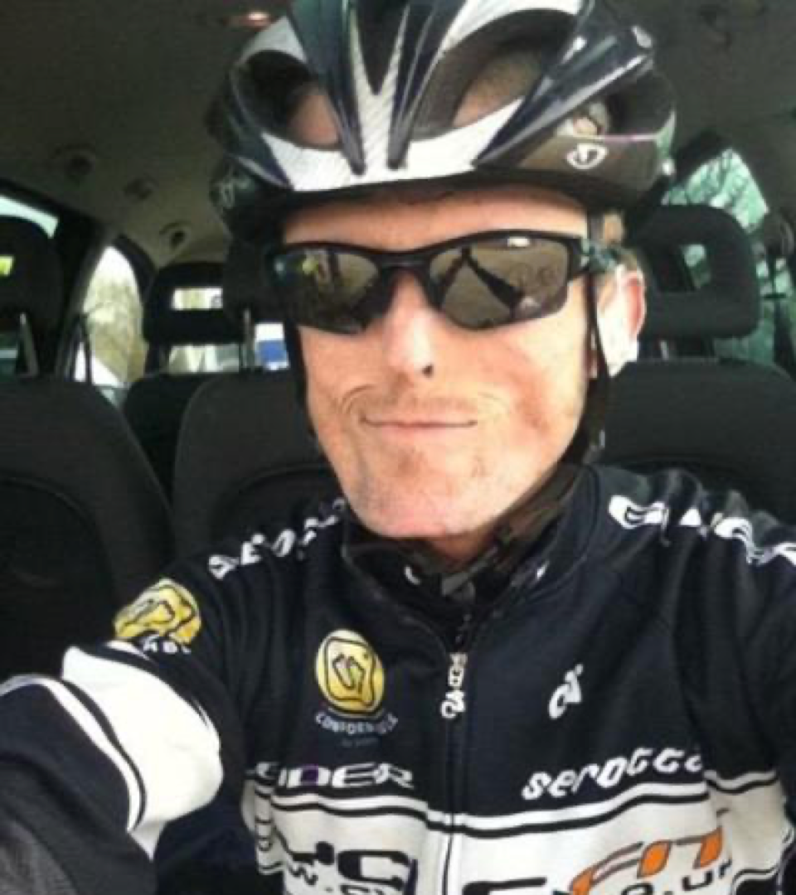

Notes:
We are all the best version of ourself and all shine in our own way.
Here is St Bradley Wiggins (left side) He is a Tour de France, Grand Tour and Gold Medal Olympic Winner.
Here is Tom Staniford (right side). He is a National Para-Cycling Circuit Race champ who has a very rare genetic condition.
While their genes are different, both are known to be the best in the cycling world.

Slide 8

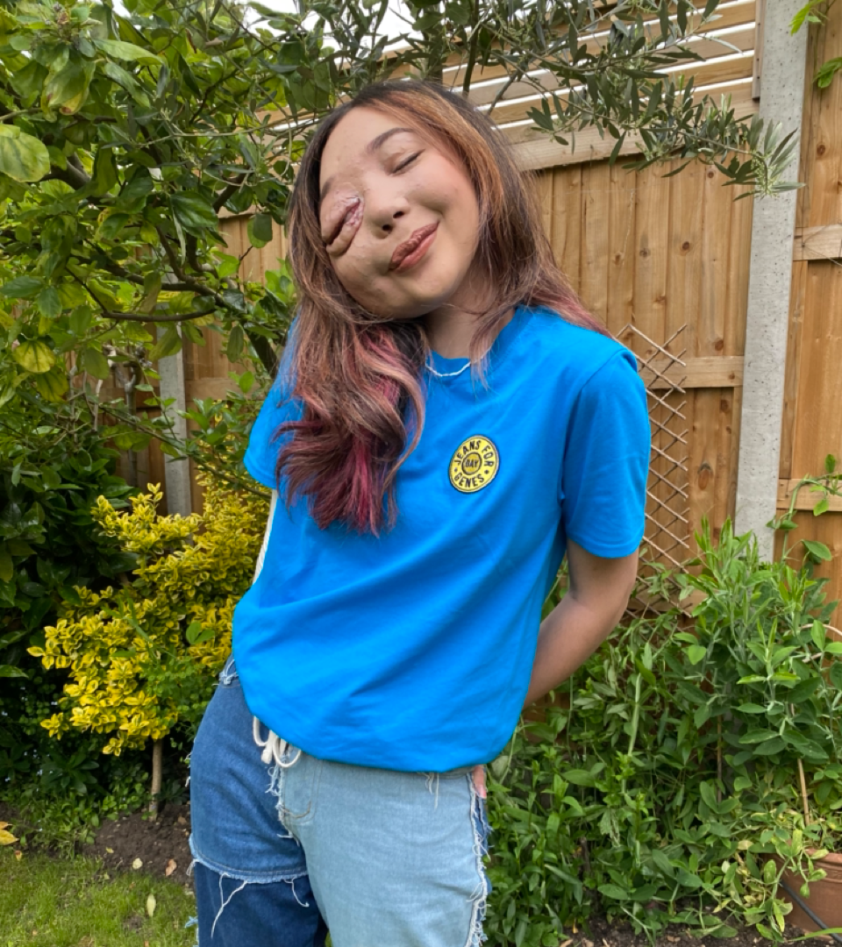
Notes:
Here is Joe Suggs (left side) He is a YouTuber & TV presenter. He was on Strictly Come Dancing and has 1.2M followers on TikTok.
Here is Nikki Lilly (right side). She is a charity campaigner, a TV presenter and has 8.4 M followers on TikTok.
While their genes make them the person they are - they have a lot in common, they are both superstars!!

Slide 9

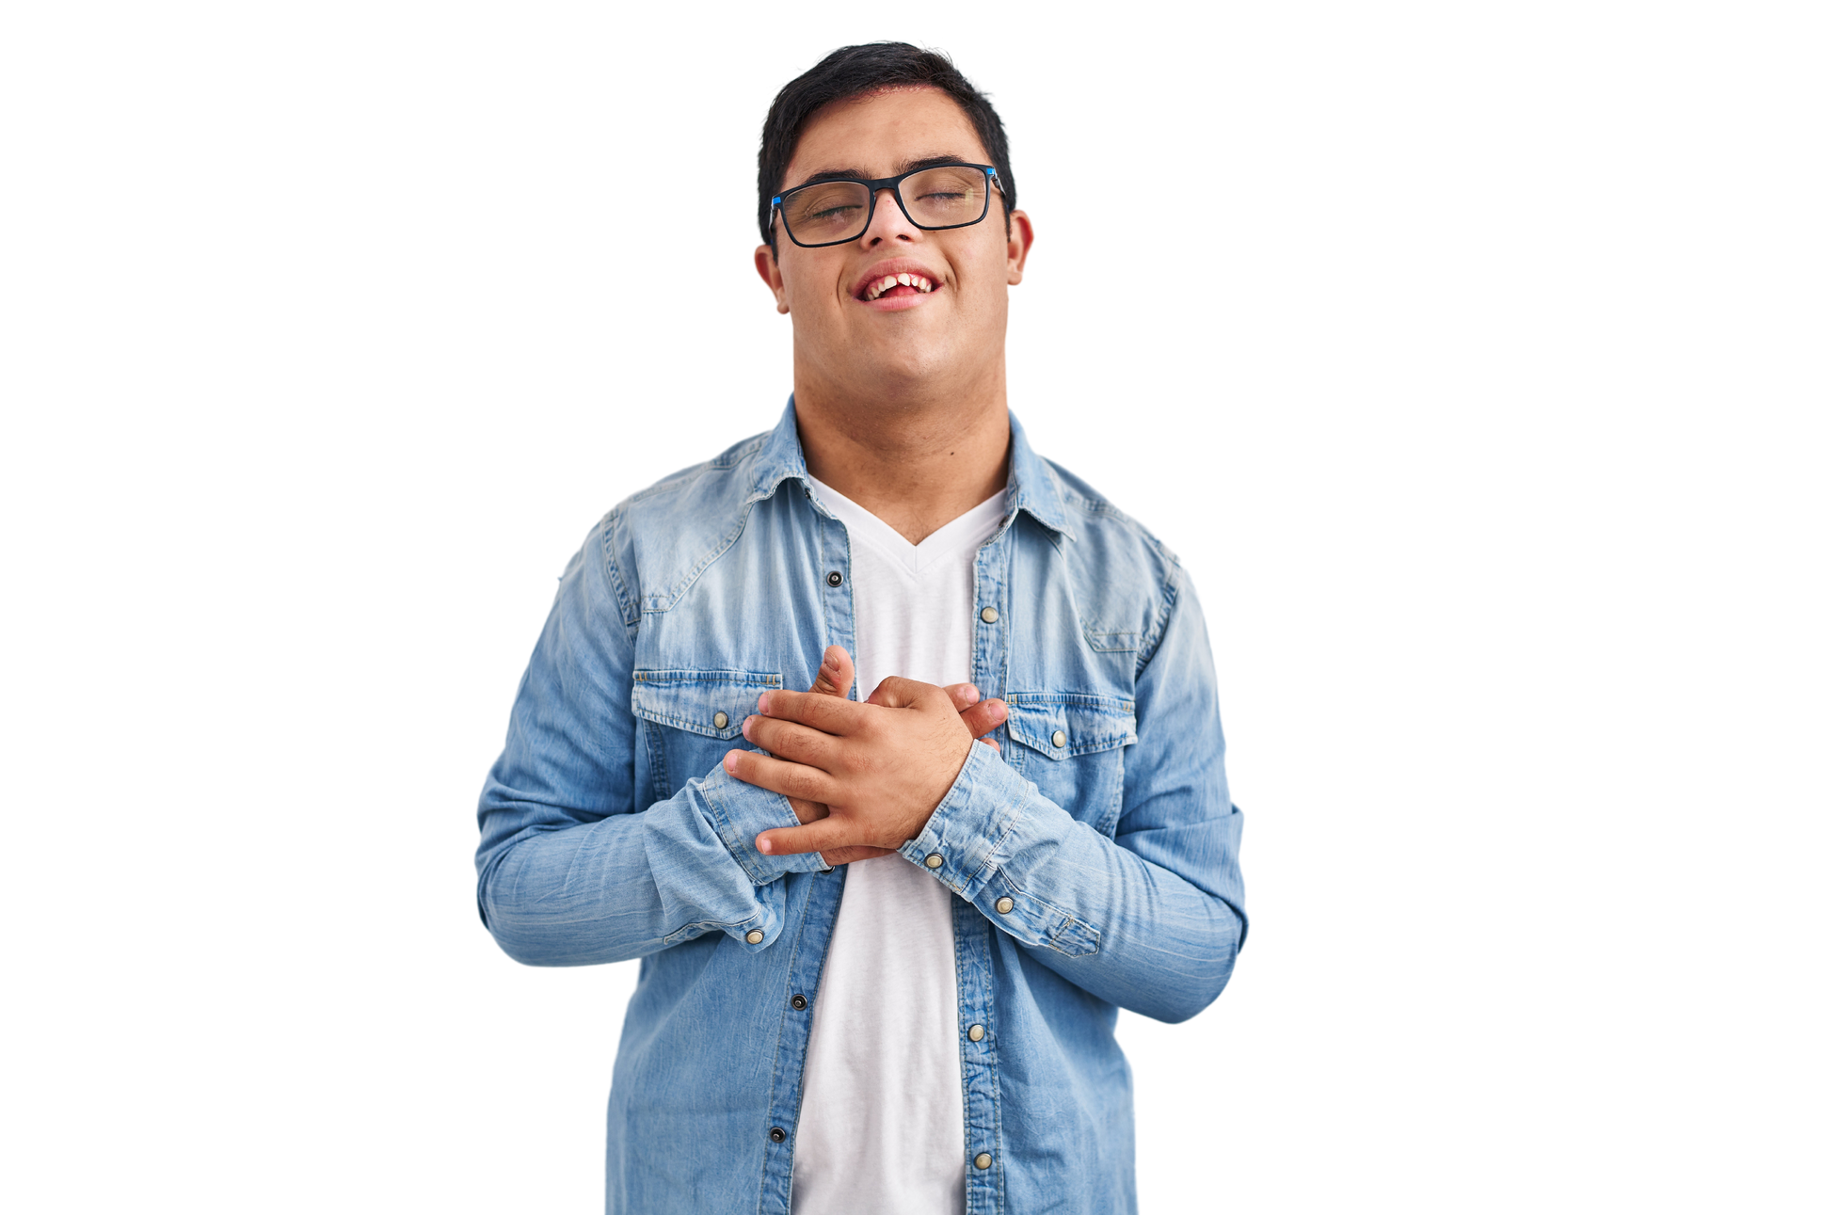






other fundraising
IDEAS
DANCE IN
DENIM
BAKE A
DIFFERENCE
SPONSORED SKIP/SWIM/SILENCE
EVENT
Notes:
Our support helps to everyone the chance they need to shine.
So is everyone excited about wearing their jeans on _____(insert date here) Shall we do something else to help raise moire money? Can anyone remember what we've done before for charity? Does anyone have any new ideas for this year?
Presenter: You could talk through the slide with your students for ideas: ie we could dance in denim, we could do a bake the difference sale or a sponsored event - there are lots of ideas online at www.jeansforgenes.org.

Slide 10
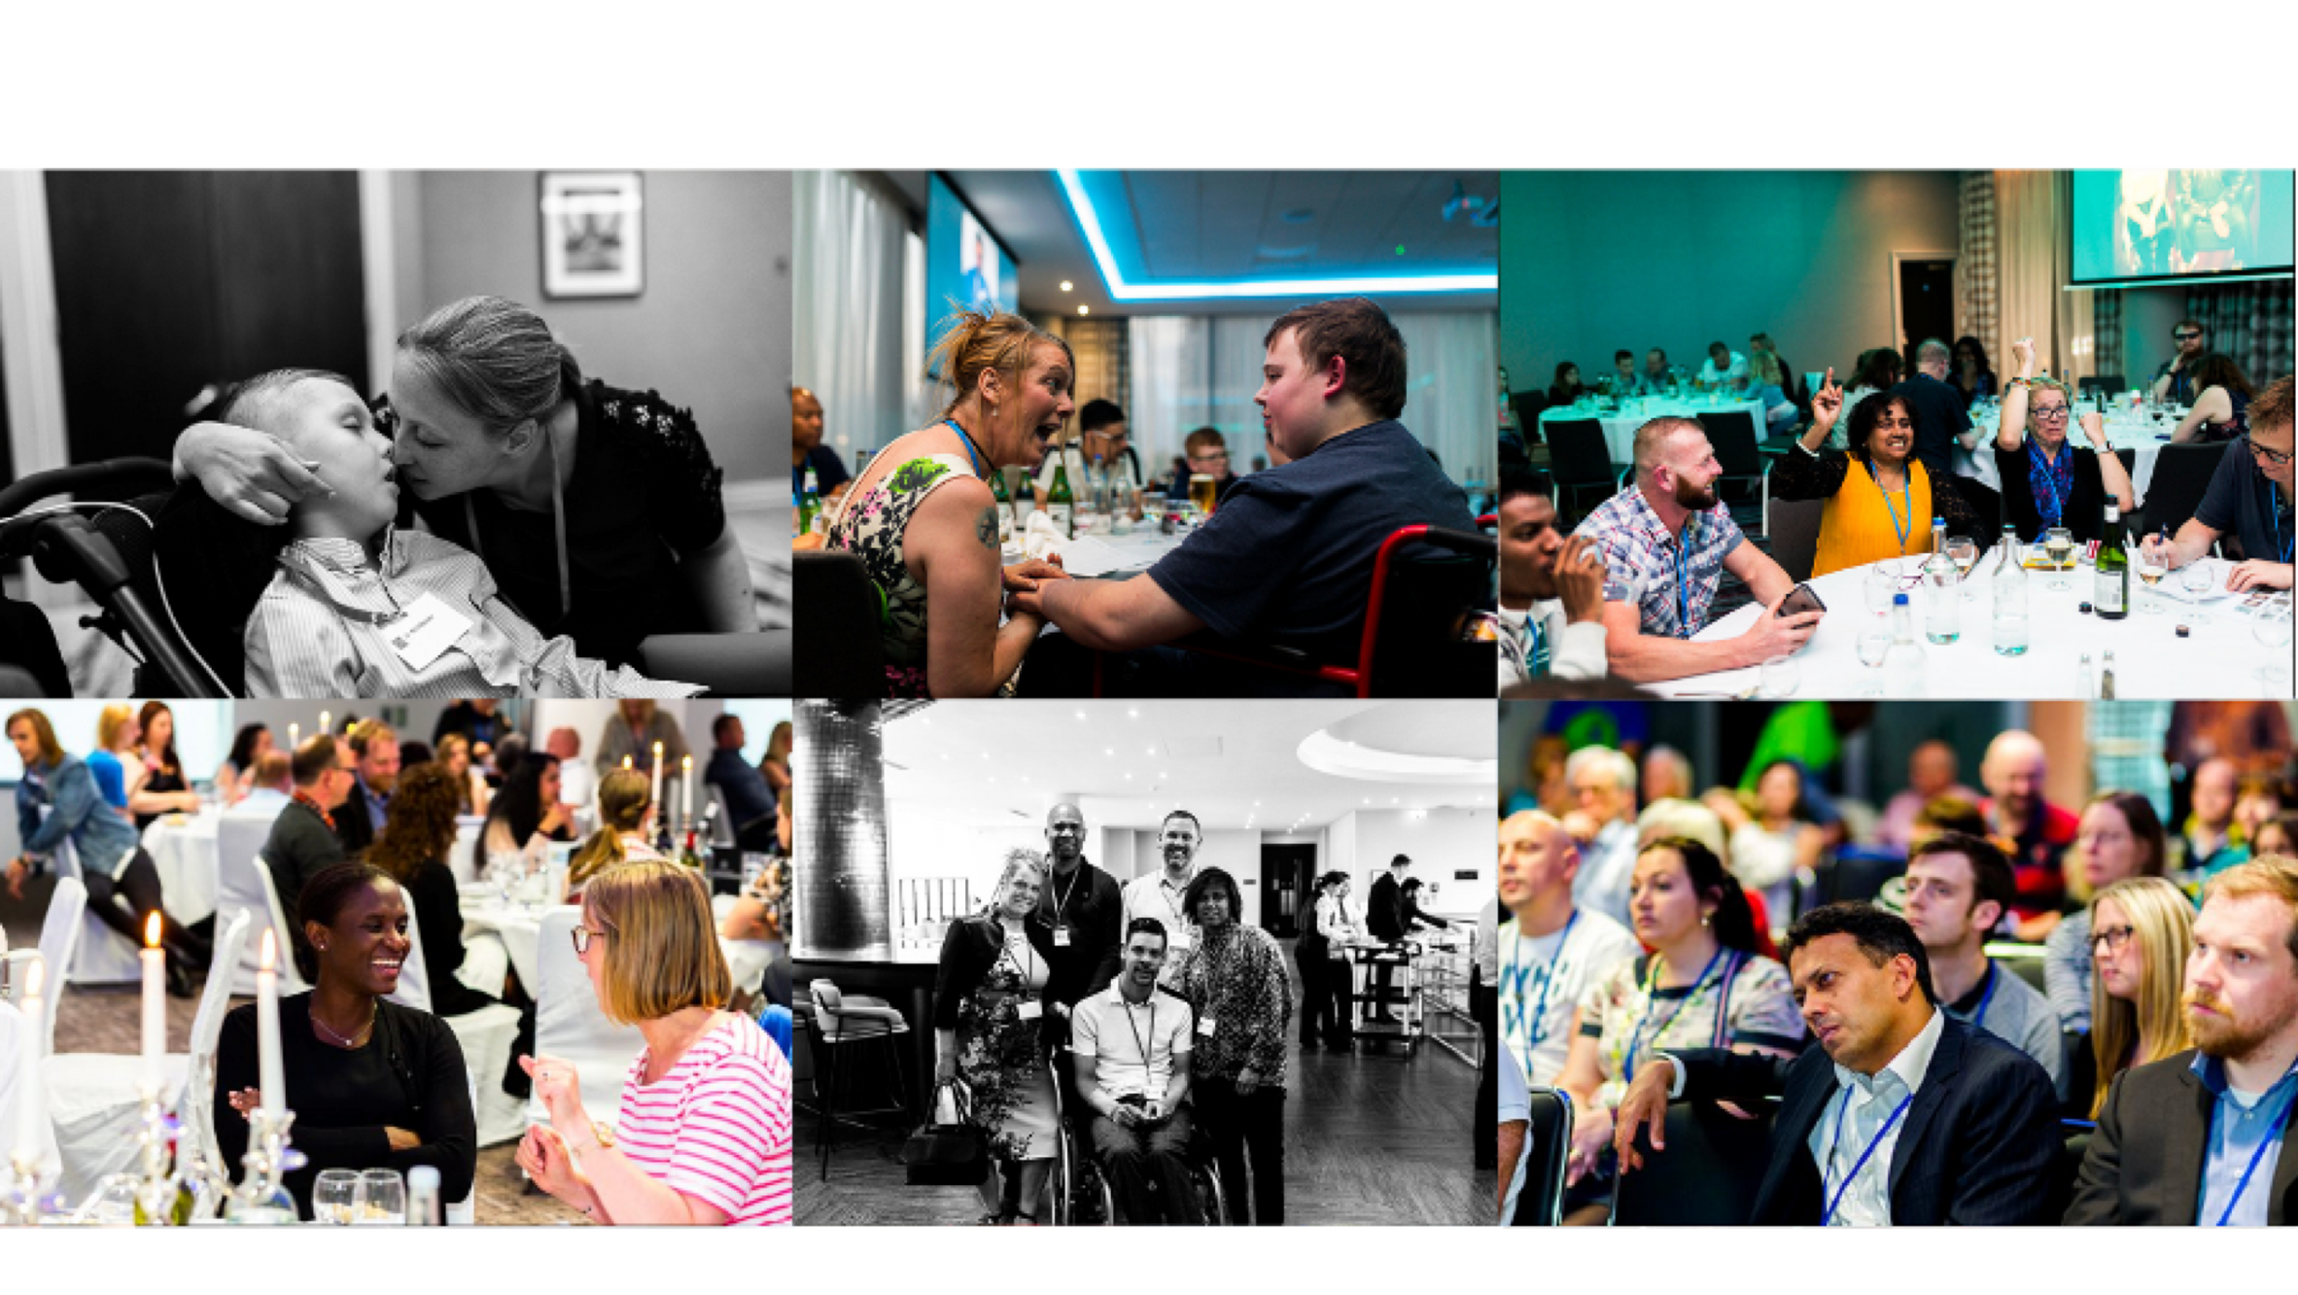
Notes:
Every year we help lots of different charities who work with children and families who have genetic conditions.
Last year, we helped a group called Alex, TLC.
Alex TLC helps very rare changes in children that affect walking, seeing, hearing and talking. Because they are very rare, sometimes Drs struggle to know what to do and how to help. This can sometimes make families feel sad and lonely.
With the help from schools and students like you, we paid for a fun weekend for all the families to learn more, to make new friends and hear from special Drs so they don't feel alone anymore.
Sometimes, listening and learning is the best thing in the world and sharing stories will help change

Slide 11
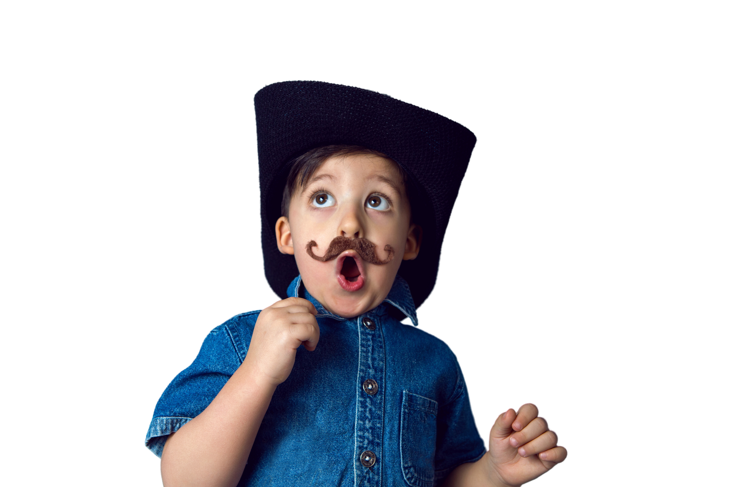

Notes:
We've heard all about Jeans for Genes and why it's important for the children and families in the UK.
Let's have as MUCH fun as possible and raise as much money as we can together!
Does anyone have any questions?

Slide 12

Notes:
Presentation ends

