Slide 1


Notes:
Hello and thank you for taking part in Jeans for Genes 2023!
Please feel free to use this secondary school presentation to help you deliver a Jeans for Genes assembly or class talk in school. It is aimed to help your students understand why their support is so incredible and how their fundraising helps the genetic condition community in the UK.
It should only take around 10 mins to deliver, which leaves plenty of time for any questions there maybe!
Although Jeans for Genes is a week long event, we find that most schools in the UK get together on the Friday (21 Sept), creating a denim tidal wave of awareness and fundraising! Have fun!
*Start presentation*

Slide 2



Notes:
What is Jeans for Genes?
Jeans for Genes is a charity here in the UK.
People raise money for Jeans for Genes by doing lots of fun activities - usually in jeans or denim!
This money helps children and families who have different needs because of the way that their bodies are made.
It takes place every September

Slide 3
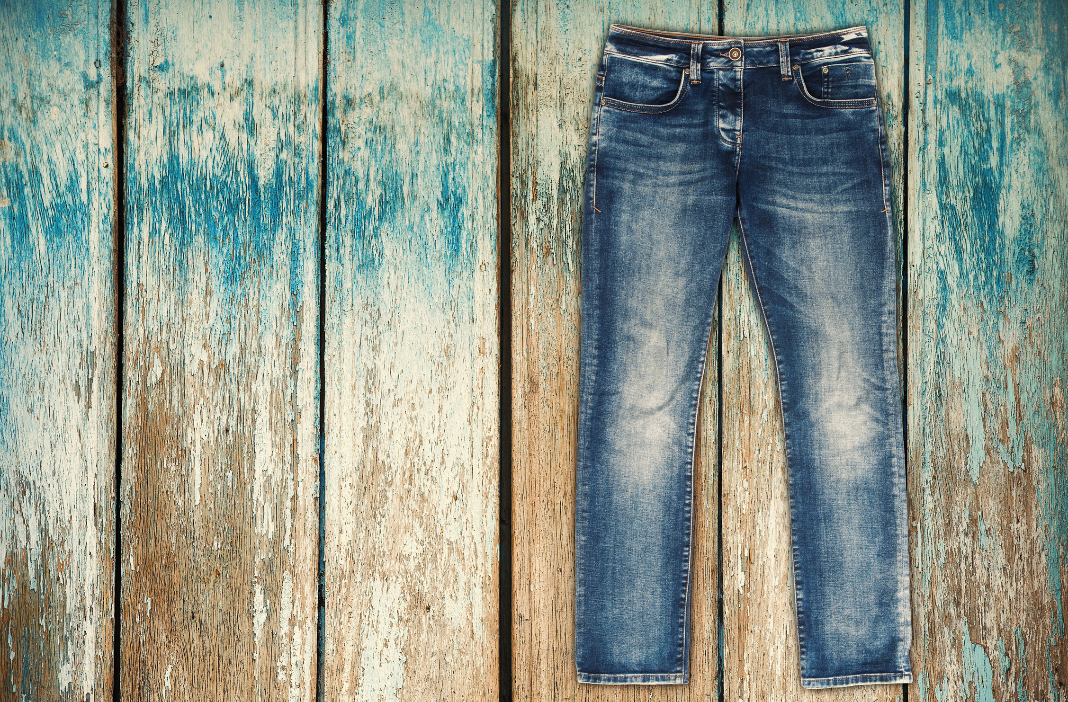
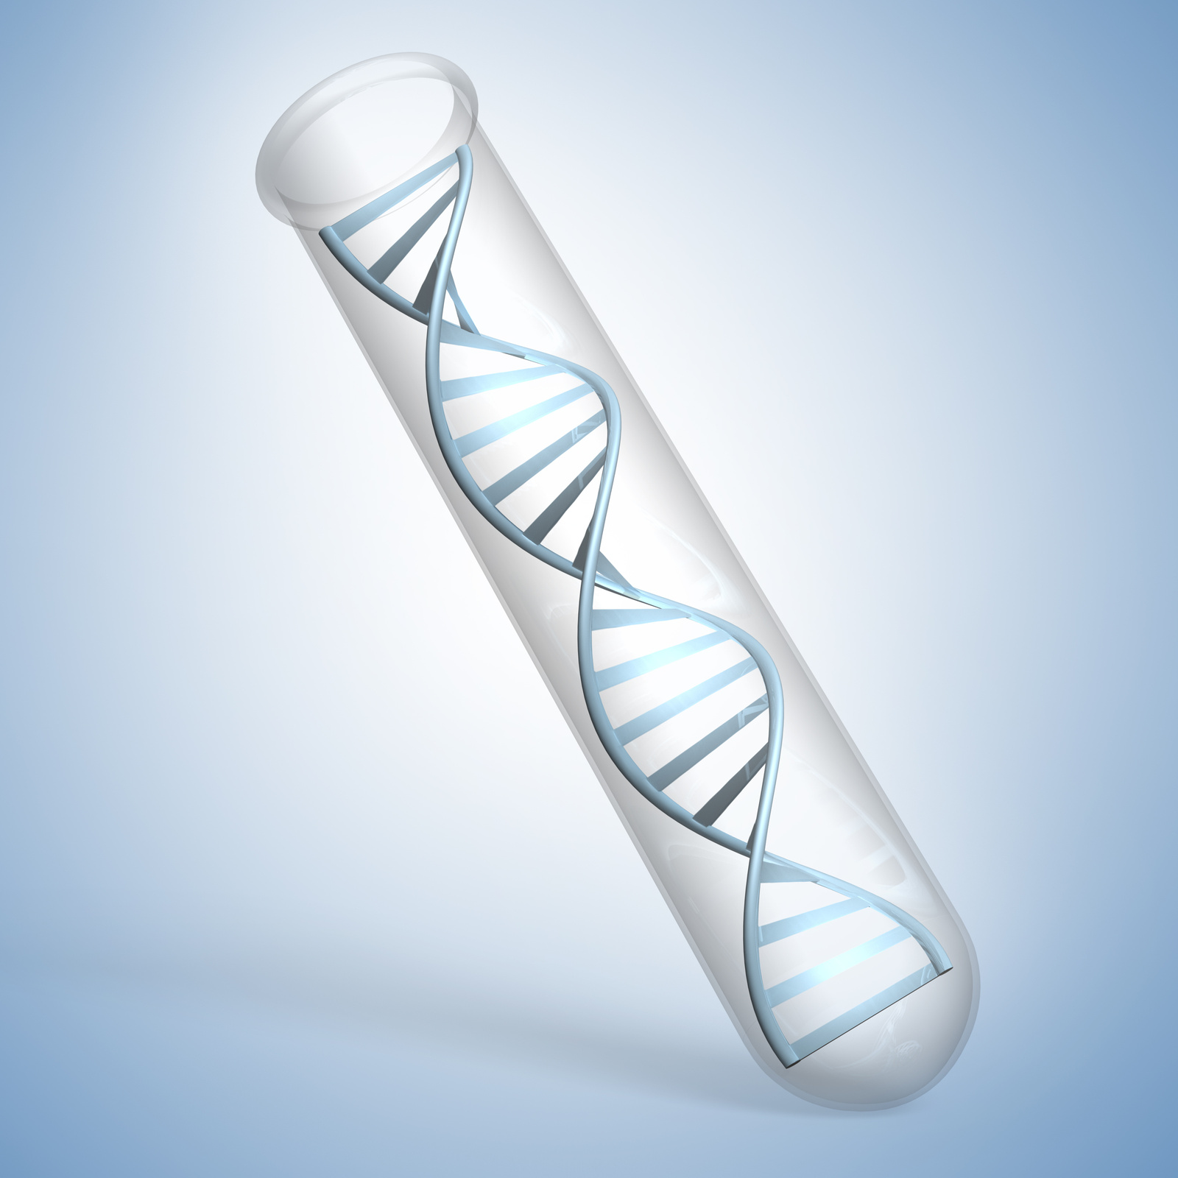
Notes:
Why the name?
JEANS
Denim remains one of the most versatile, durable and highly sought after fabrics on the market. Jeans transcends gender, age, and class – with most people owning more pairs than there are days in the week. Their appeal will always be timeless but the design and the fabric technology involved will forever evolve with the times.
FUN FACT:
Where does the word Jeans come from?
The word Jeans comes from a twilled cotton fabric called ‘Genoa fustian’; often used to make durable workwear. Labourers in the United States referred to their workwear as ‘ Jeans’, after the city Genoa, where the fabric was initially woven.
----
GENES
The basic unit of heredity passed from parent to child. Genes are made up of sequences of DNA and are arranged, one after another, at specific locations on chromosomes in the nucleus of cells.
A genetic condition occurs when you inherit an altered (changed) gene from your parents that increases your risk of developing that particular condition. However not all genetic conditions are passed down from your parents, some gene changes occur randomly before you are born.

Slide 4

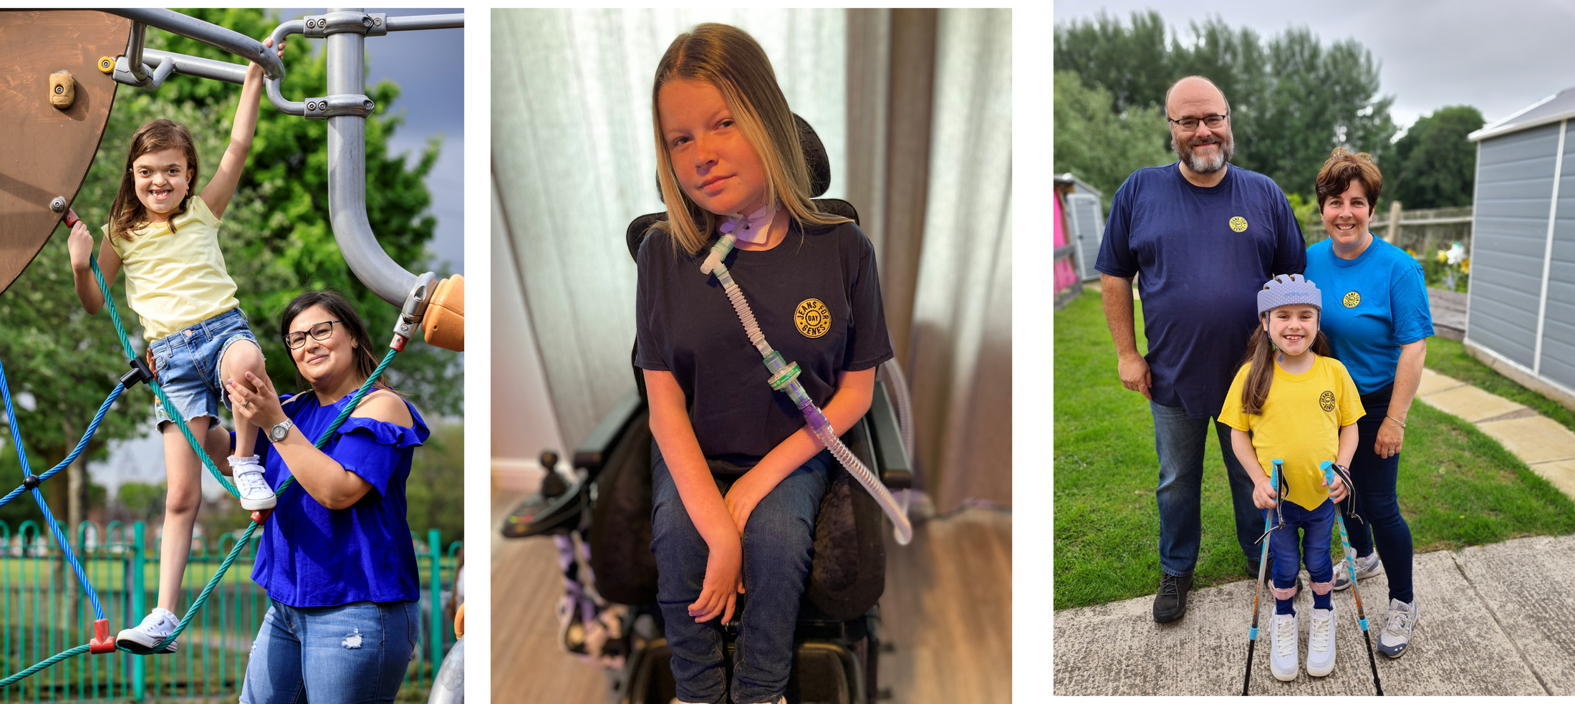
Why we need
YOUR HELP
Notes:
Why do we need your help?
1 in 25 children have different genes - which is 1 in 10 families in the UK.
For people with different genes, life can be difficult. It could be when they are babies and need a special nurse to help or when they go to school and need special equipment.
With your help, we can make sure that they get treatment and medical help when they need it.
Your help changes lives and makes a world of difference!

Slide 5
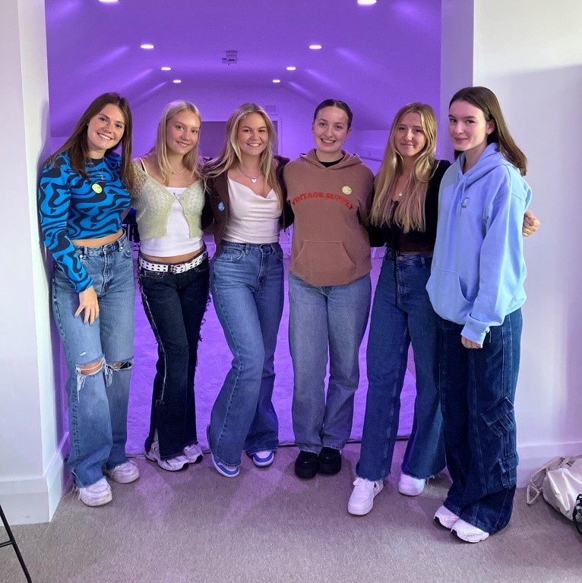
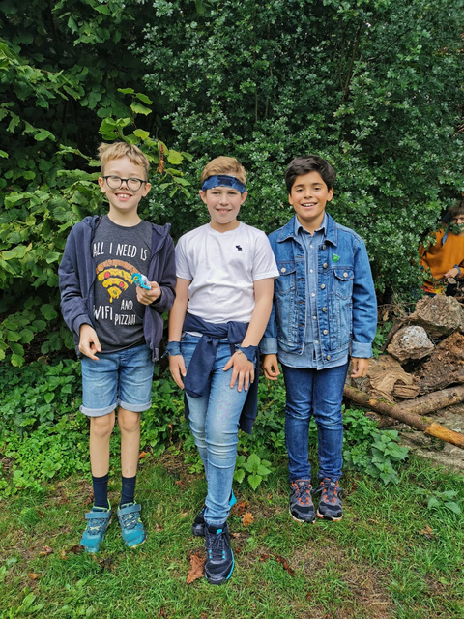
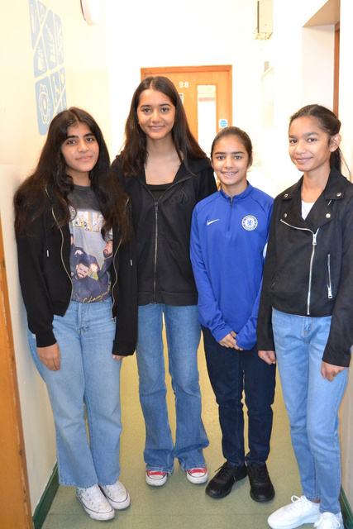
Better
TOGETHER
One way we have of raising money for Jeans for Genes is by simply wearing our jeans or some denim into school on a chosen day.
Simply bring £1 and all this money will help children all across the UK get access to the equipment, nurses and services that they need.
This is something EVERYONE can get involved with - students, teachers and Head Teachers alike!
Notes:
It's time to wear our jeans, do some good and have a lot of fun at the same time!
Every year we bring pupils, schools, workplaces and people together to help over 4 million people in the UK.
Let's make this year our best one yet!

Slide 6


Slide 7
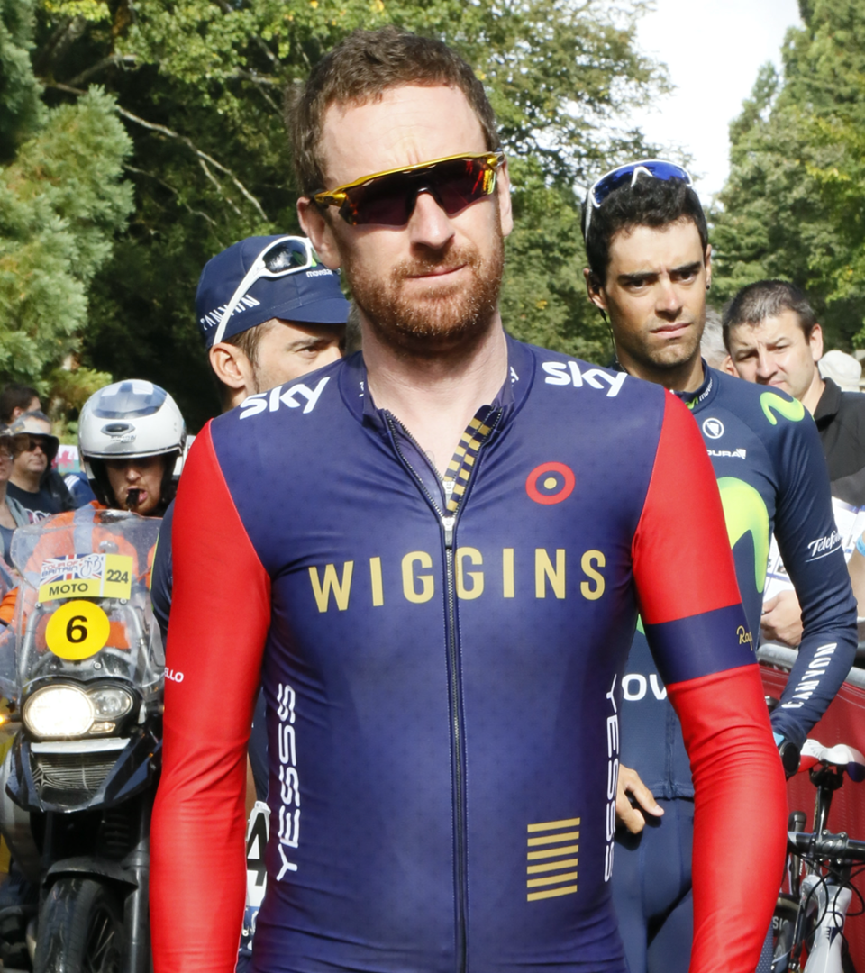
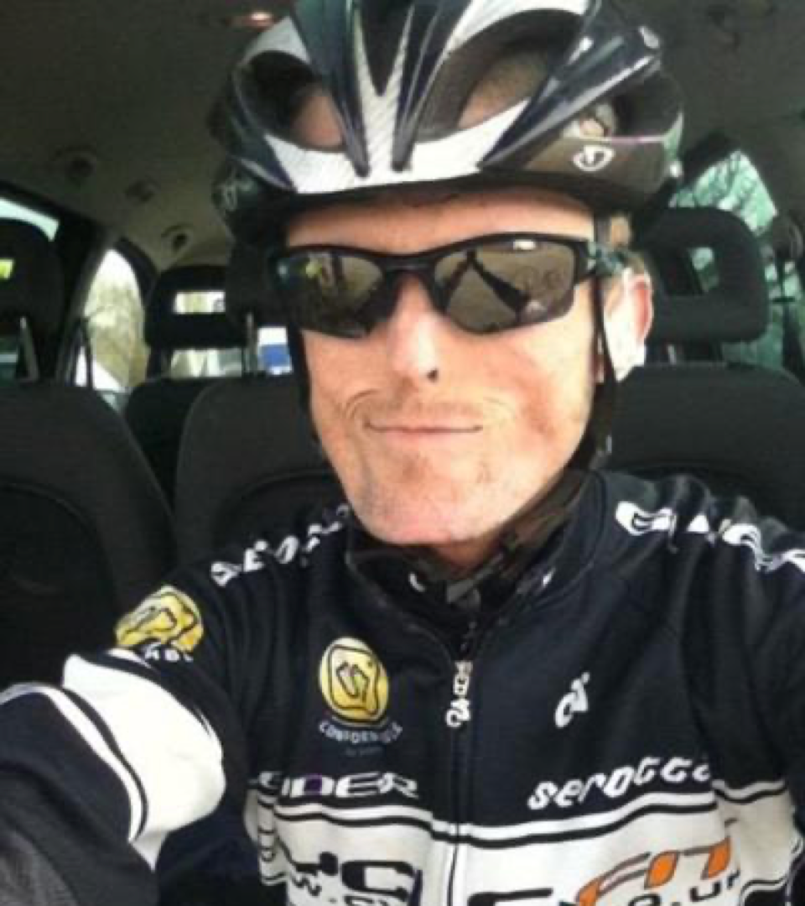

Notes:
We are all the best version of ourself and all shine in our own way.
Here is St Bradley Wiggins (left side) He is a Tour de France, Grand Tour and Gold Medal Olympic Winner.
Here is Tom Staniford (right side). He is a National Para-Cycling Circuit Race champ who has a very rare genetic condition.
While their genes make them different, they share a competitive drive that sets them as cycling champions in their chosen disciplines.

Slide 8

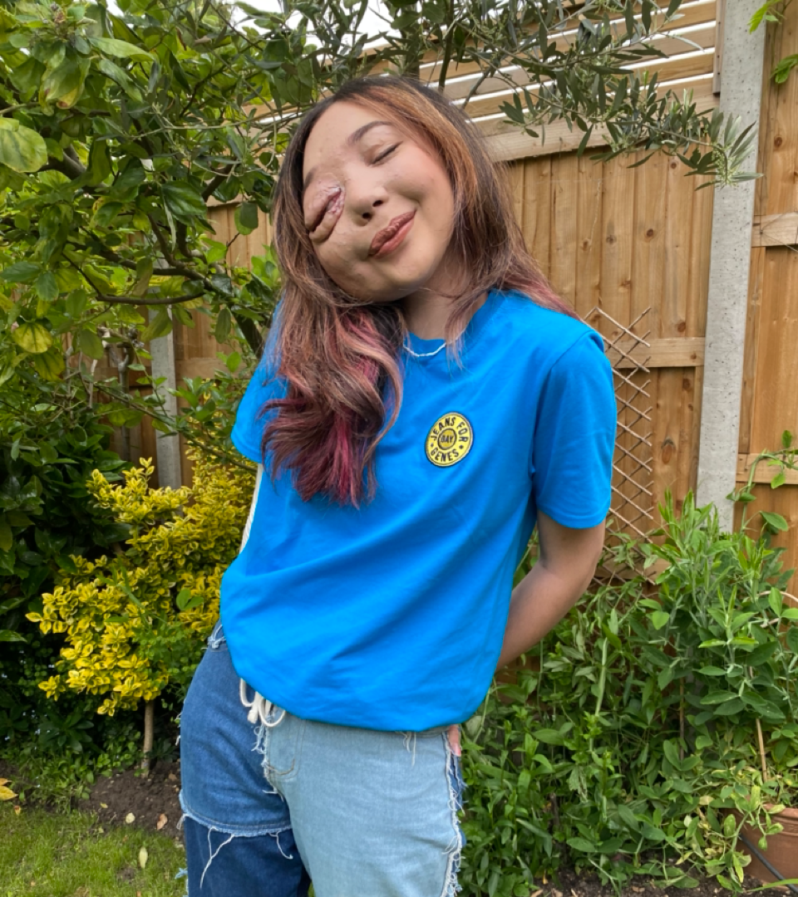
Notes:
This Joe Suggs (left side) Joe is a YouTuber & TV presenter. He was on Strictly Come Dancing and has 1.2M followers on TikTok.
And here is Nikki Lilly (right side). She is a charity campaigner, a TV presenter and has 8.4 M followers on TikTok.
Despite different genetic make up, these two have a lot in common - they are both very likeable, popular influencers AND very successful in the industry.

Slide 9

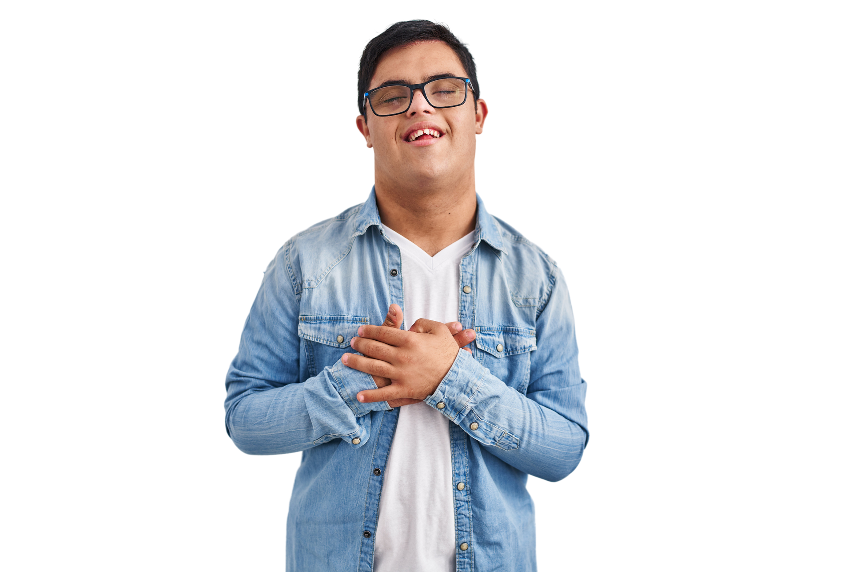






other fundraising
IDEAS
DANCE IN
DENIM
BAKE A
DIFFERENCE
SPONSORED SKIP/SWIM/SILENCE
EVENT
Notes:
Every penny makes a difference and that's why they call it change!
We are holding a Jeans for Genes day on _______ (insert date) Shall we do something else to help raise more money? Can anyone remember what we've done before for charity? Does anyone have any new ideas for this year?
Presenter: You could talk through the slide with your students for ideas: ie we could dance in denim, we could do a bake the difference sale or a sponsored event - there are lots of ideas online at www.jeansforgenes.org.

Slide 10
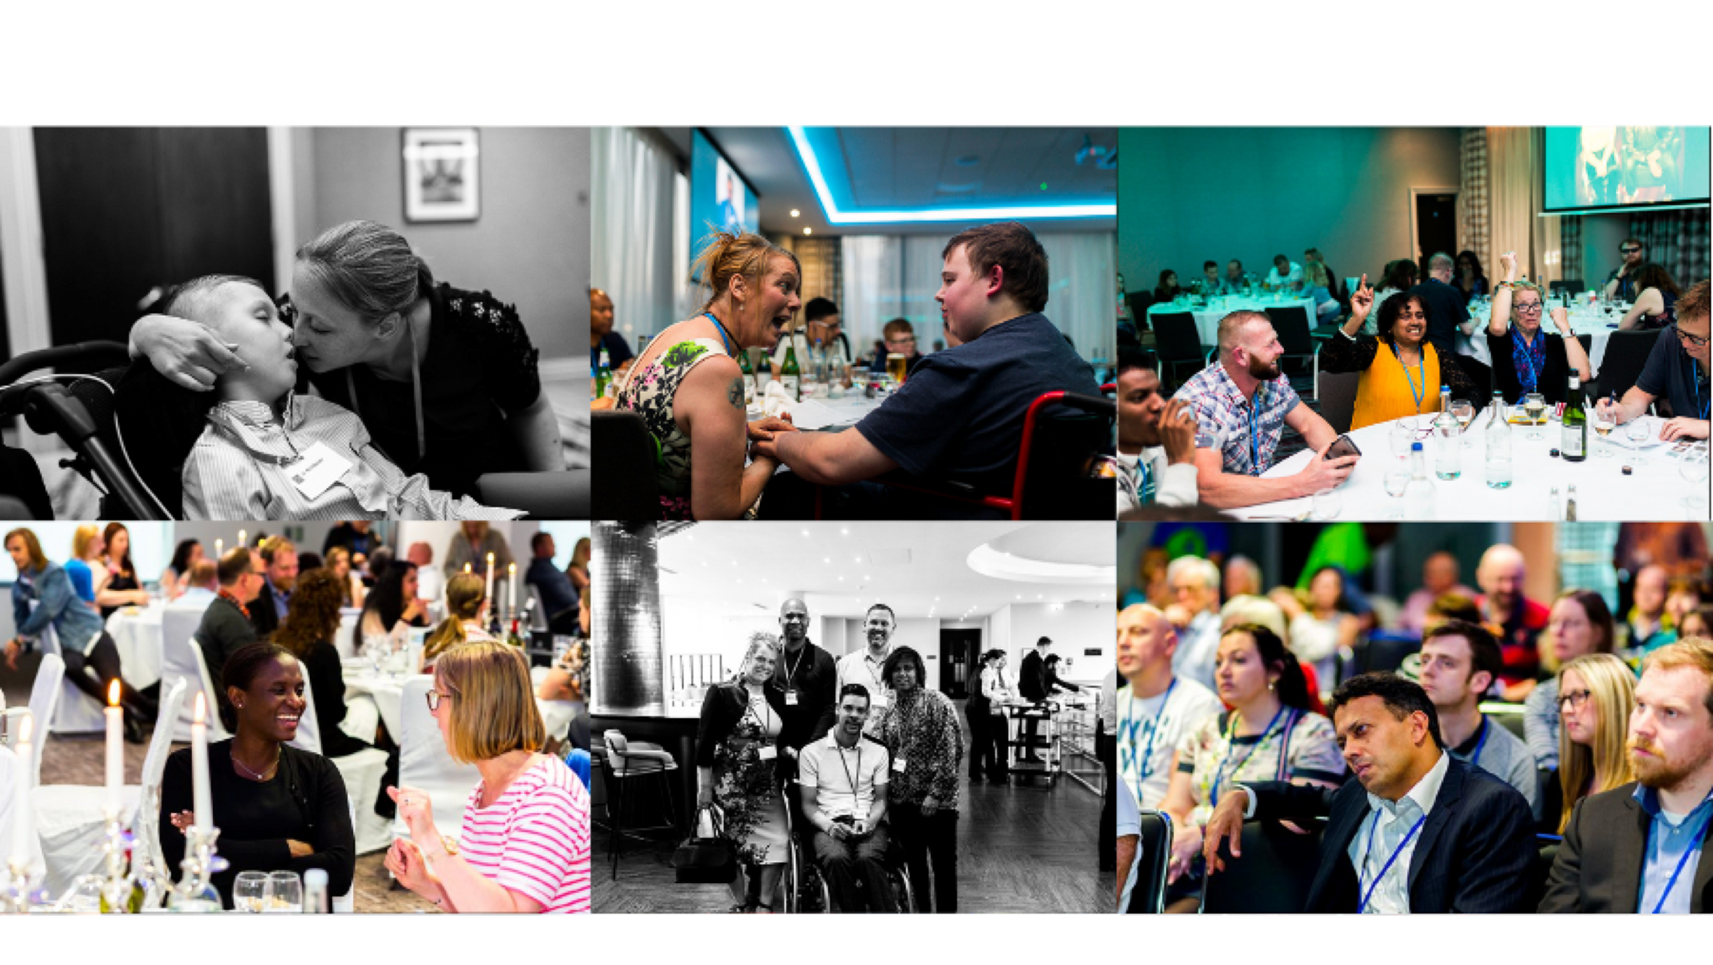
Notes:
Every year we help lots of different charities who work with children and families who have genetic conditions.
Leukodystrophies are a group of over 100 rare genetic conditions primarily affecting the white matter of the central nervous system. Some are so rare they are yet to be named.
Leukodystrophies can affect anyone: males and females of any age and ethnicity, most notably children, usually with no previous indication. They are often misdiagnosed and are poorly understood within the medical community, rendering adequate care and treatment widely inaccessible. Those affected often feel disempowered and isolated, struggling to cope with their situation and unable to access the help they need.
A Jeans for Genes grant is helping to fund this year’s Alex TLC Community Weekend which will bring together patients, carers, families, doctors, researchers, scientists, and patient advocates from around the world. The event gives patients and family members the opportunity to talk openly about leukodystrophy and to build long lasting and supportive relationships.
The feeling of being properly heard and understood is deeply transforming, thanks to you.

Slide 11


Notes:
We've heard all about Jeans for Genes and why it's important for the children and families in the UK.
Let's have as MUCH fun as possible and raise as much money as we can together!
Does anyone have any questions?

Slide 12

Notes:
Presentation ends

