Slide 1


Notes:
Hello and thank you for taking part in Jeans for Genes 2024!
Please feel free to use this presentation to help you deliver a Jeans for Genes assembly or class talk in school. It is aimed to help your students understand why their support is so incredible and how their fundraising helps the genetic condition community in the UK.
It should only take around 10 mins to deliver, which leaves plenty of time for any questions there maybe!
Although Jeans for Genes is a week long event, we find that most schools in the UK get together on the Friday (20 Sept), creating a denim tidal wave of awareness and fundraising! Have fun!

Slide 2
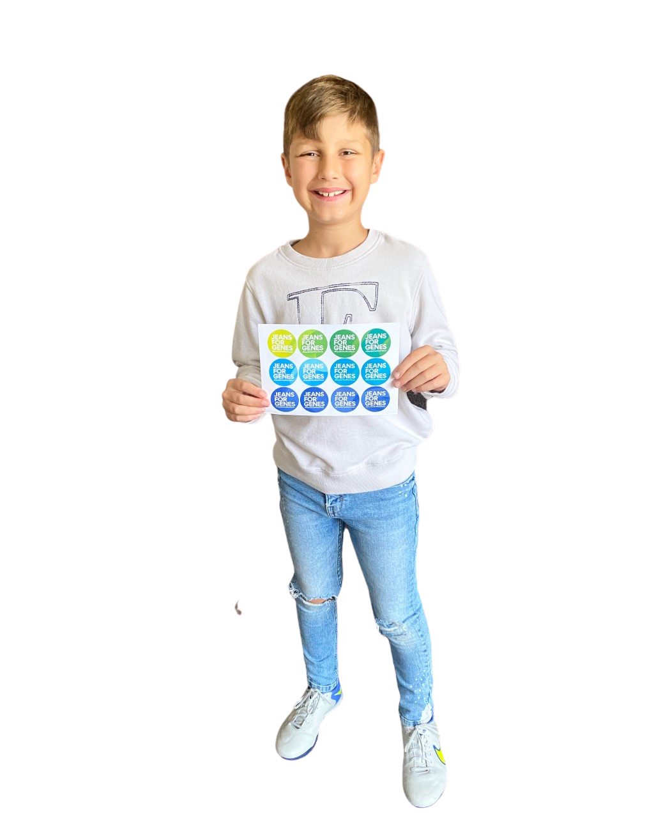
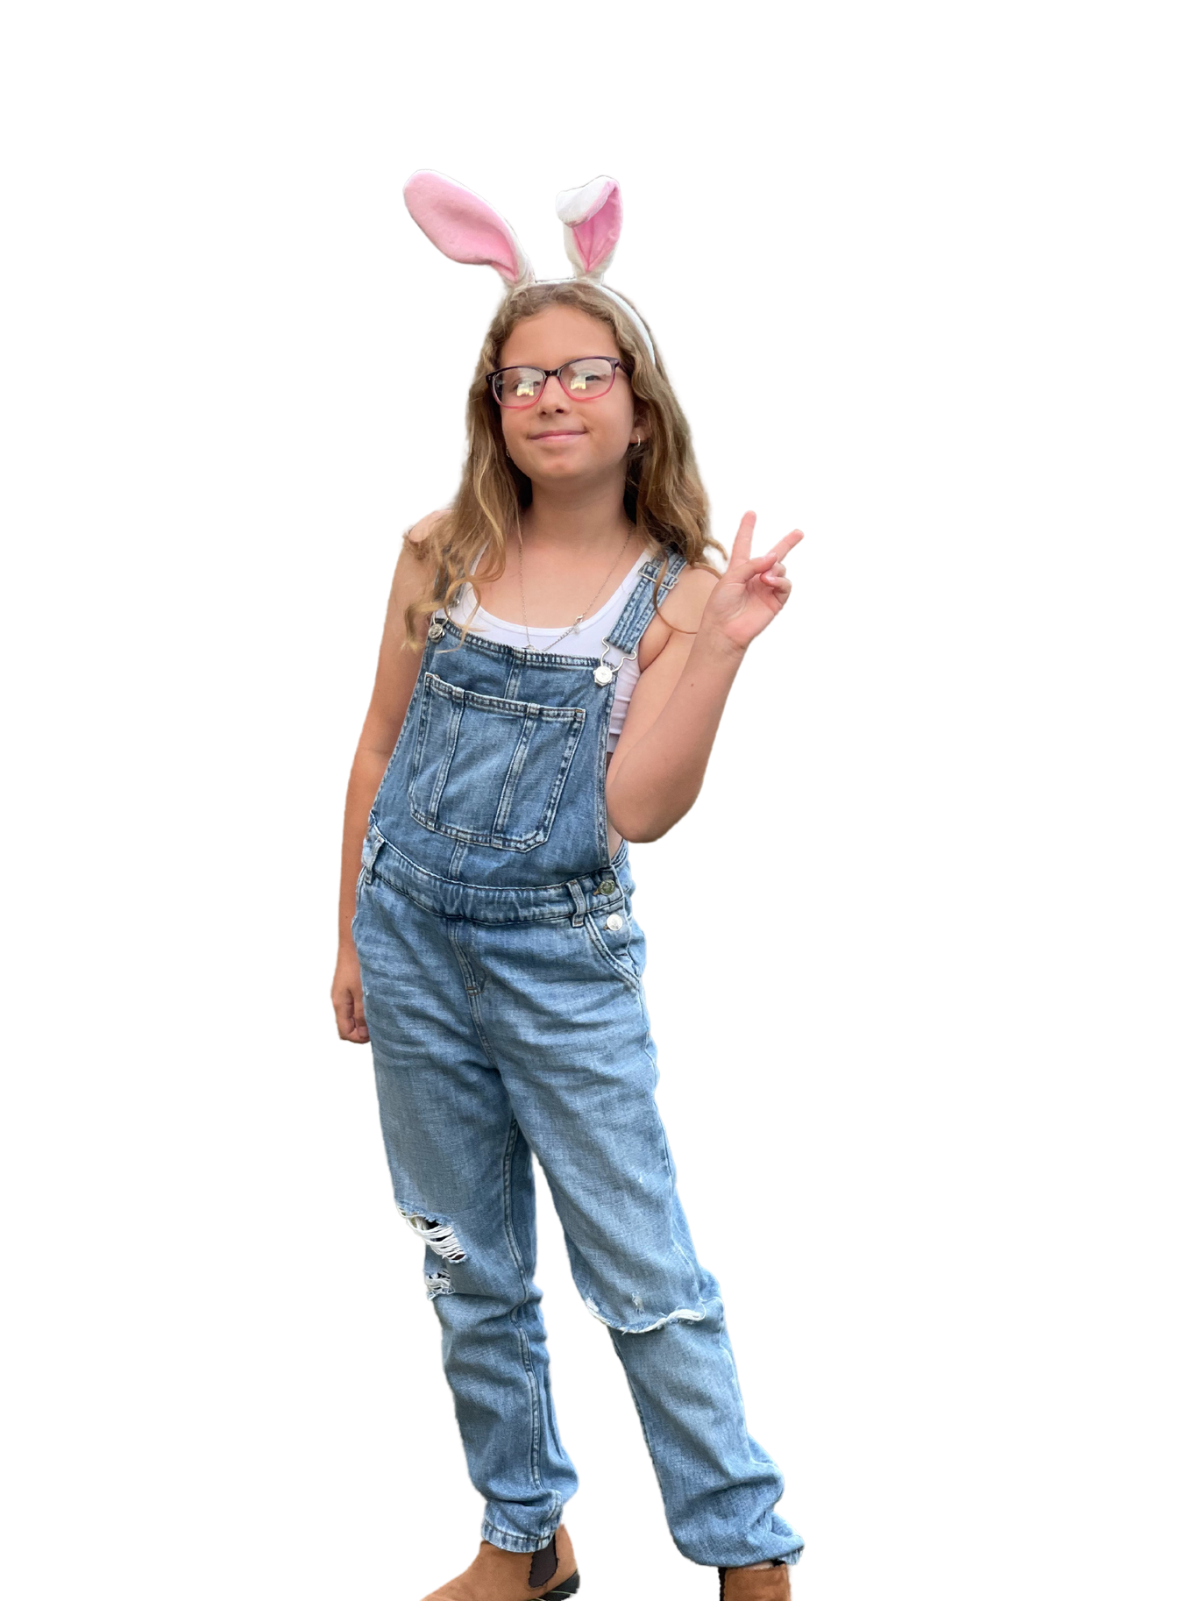

Notes:
What is Jeans for Genes?
Jeans for Genes is a charity here in the UK.
People raise money for Jeans for Genes by doing lots of fun activities - usually in jeans or denim!
This money helps children and families who have different needs because of the way that their bodies are made.
It takes place every September

Slide 3


Notes:
Slide shows jeans left hand side and genes right hand side.
What are these? (point to jeans) JEANS! We wear them and they can be all different sorts of styles and come in many different shades of blue and lots of other clothes.
What are these? (point to genes) These are our GENES! They make us who we are and they also give us our freckles, our eye colour and our hair colour. Sometimes, when the genes are a little different, they can affect how we walk or talk and how our bodies move. The name for this is 'genetic condition'.

Slide 4

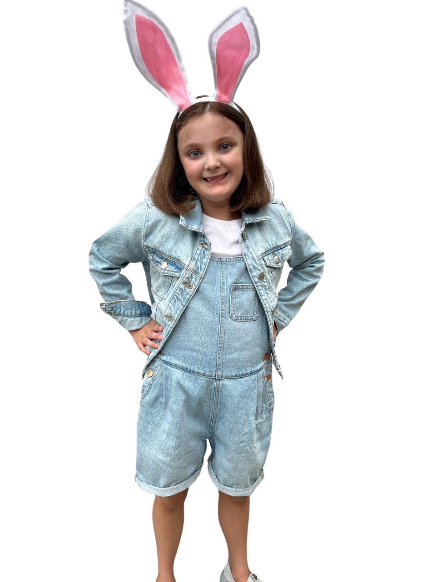
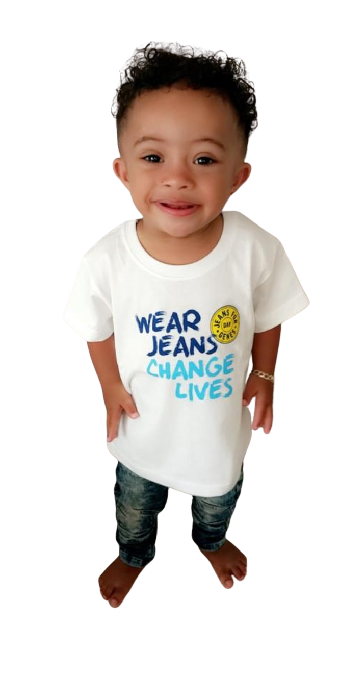
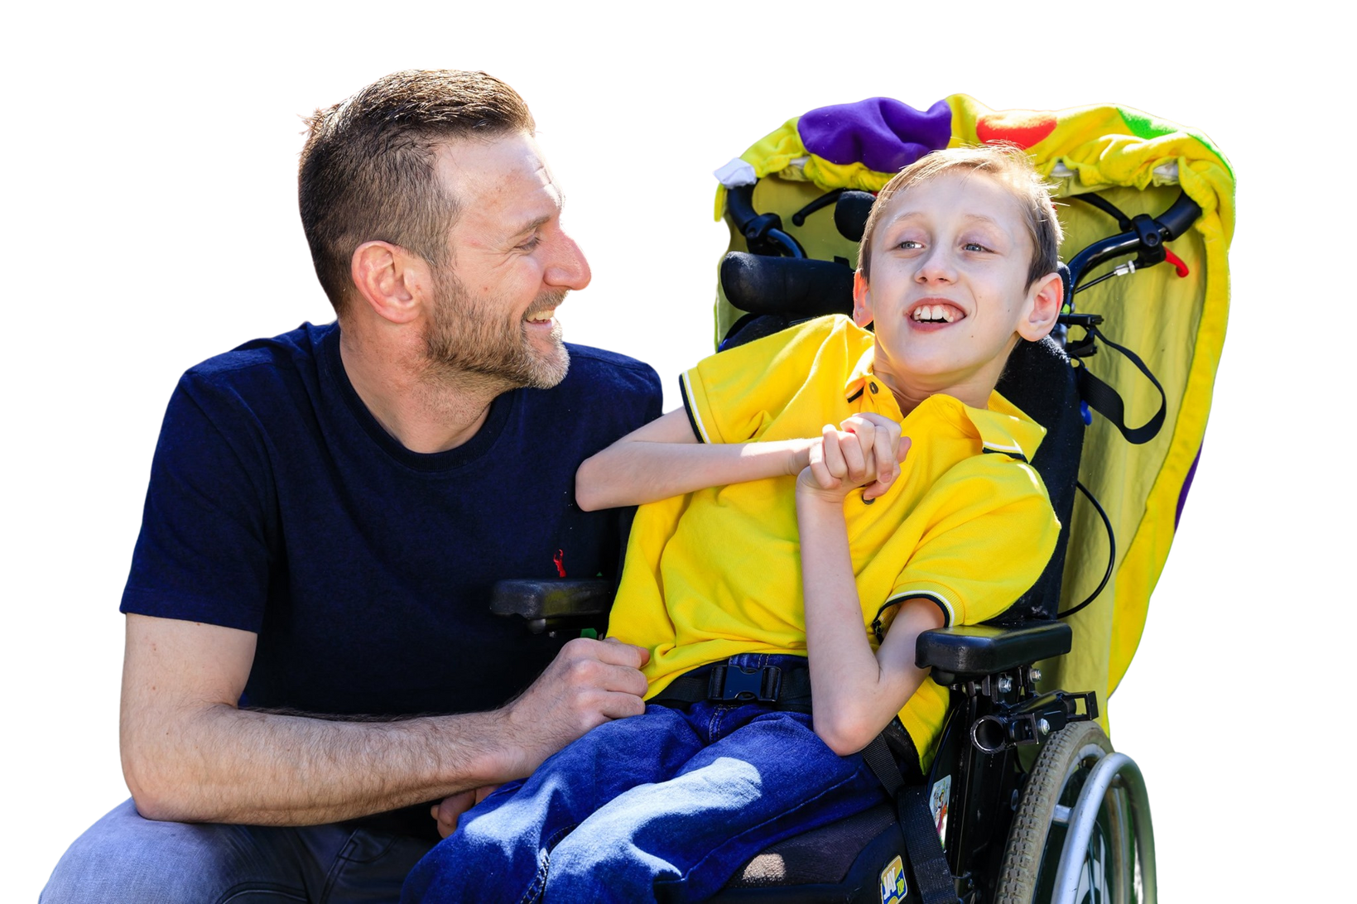
Notes:
Jeans for Genes helps families who have different needs, due to their genes.
This might mean they need special equipment or special nurses to help them.
The money we raise together helps all sorts of families across the country - whatever their need is

Slide 5
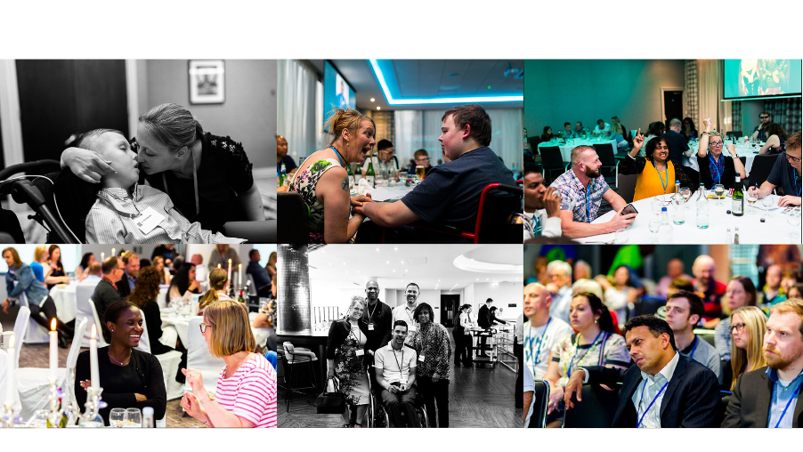
Notes:
Every year we help lots of different charities who work with children and families who have genetic conditions.
Last year, we helped a group called Alex, TLC.
Alex TLC helps very rare changes in children that affect walking, seeing, hearing and talking. Because they are very rare, sometimes Drs struggle to know what to do and how to help. This can sometimes make families feel sad and lonely.
With the help from schools and students like you, we paid for a fun weekend for all the families to learn more, to make new friends and hear from special Drs so they don't feel alone anymore.
Sometimes, listening and learning is the best thing in the world and sharing stories will help change lives, thanks to people like you!

Slide 6
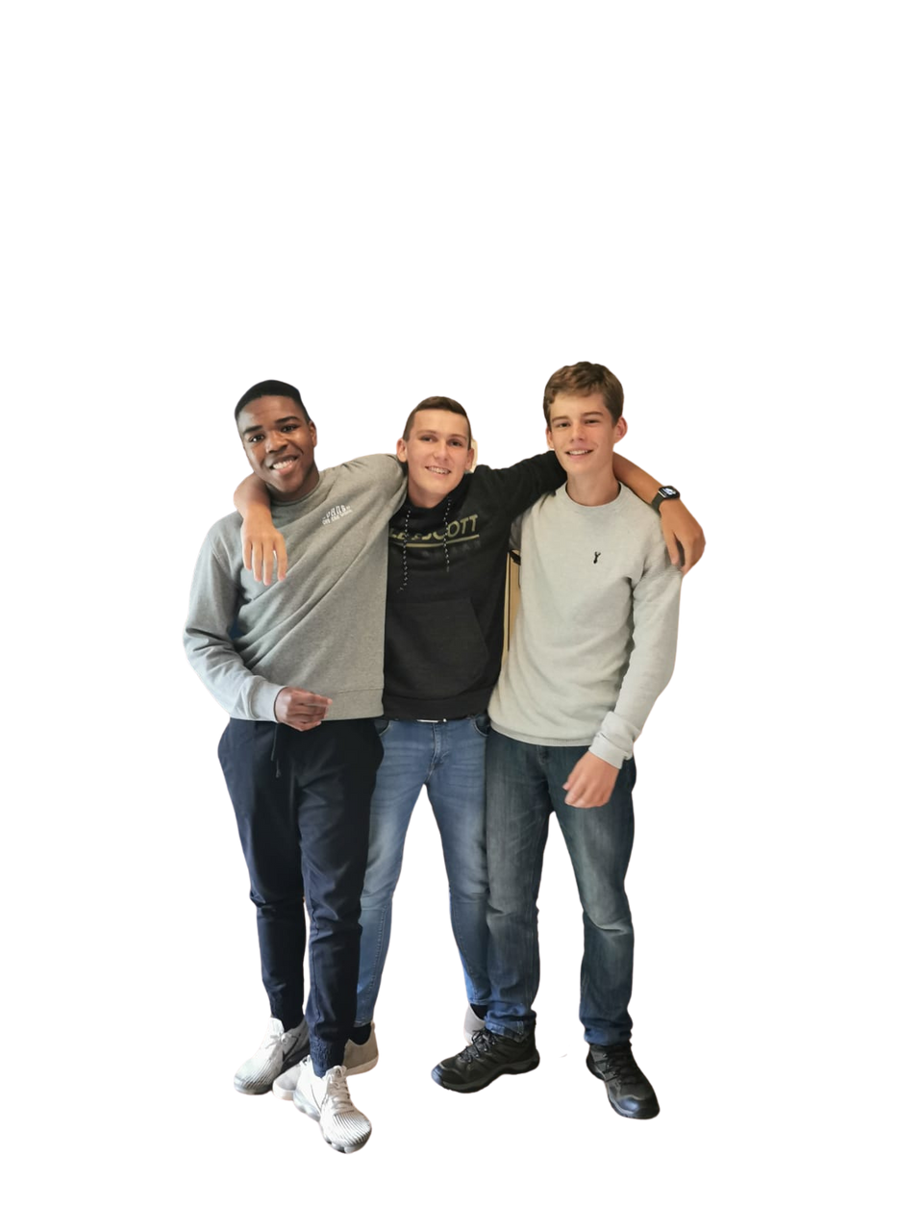

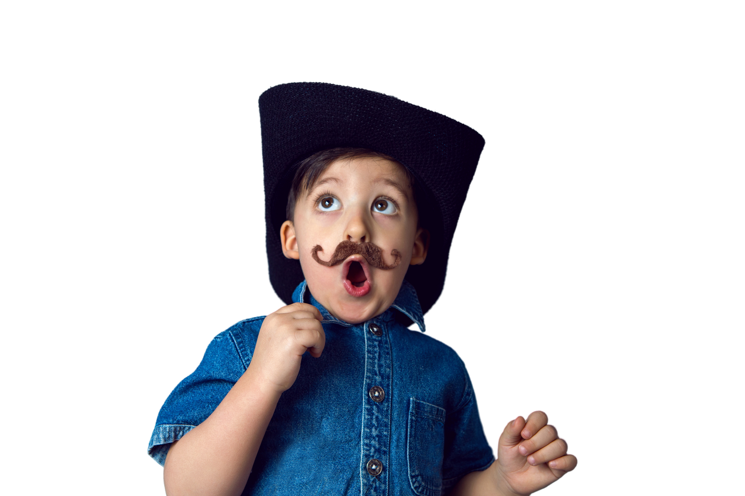





how you can
HELP
Notes:
How can you and your school help?
You could help by....
1. Wearing jeans or denim to school on Friday 20 September and bringing in a donation of £1
2. By organising a 'bake a difference' sale and selling yummy treats
3. By doing a sponsored dance, silence, doodle or spell
4. By thinking of something new and exciting that you can do and get everyone involved!
There are ideas on our website [jeansforgenes.org] or sign up for a free fundraising pick!

Slide 7
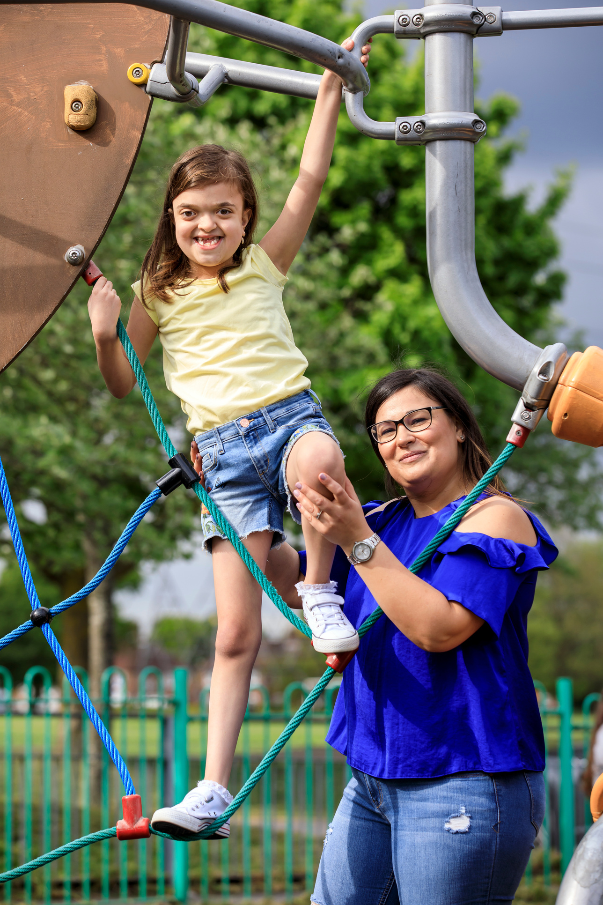
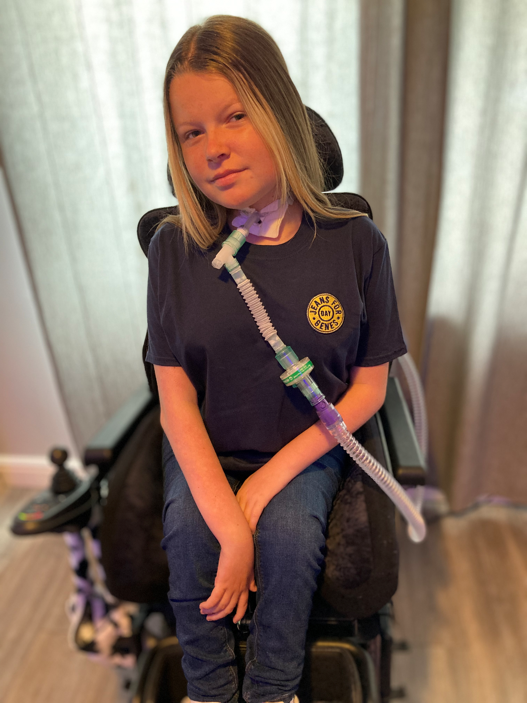
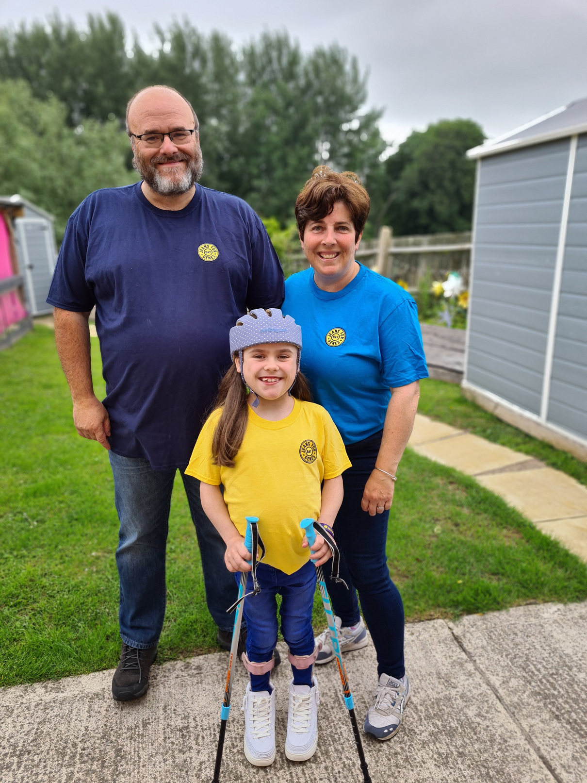
why we need
YOUR HELP
Notes:
Why do we need your help?
1 in 25 children have different genes - which is 1 in 10 families in the UK.
For people with different genes, life can be difficult. It could be when they are babies and need a special nurse to help or when they go to school and need special equipment.
With your help, we can make sure that they get treatment and medical help when they need it.
Your help changes lives and makes a world of difference!

Slide 8


